Slide 1
Chapter 5 Practice Set

Slide 2
Change the following IP addresses from dotted-decimal notation to binary notation: 114.34.2.8
114/2 = 57 R 0 57/2 = 28 R 1 28/2 = 14 R 0
14/2 = 7 R 0 7/2 = 3 R 1 3/2 = 1 R 1
1 / 2 = 0 R 1
01110010 00100010 00000010 00001000

Slide 3
Change the following IP addresses from dotted-decimal notation to hexadecimal notation:114.34.2.8
114/16 = 7 R 2, 34/16 = 2 R 2, 2/16 = 0 R 2
0x72 22 02 08
72220208h

Slide 4
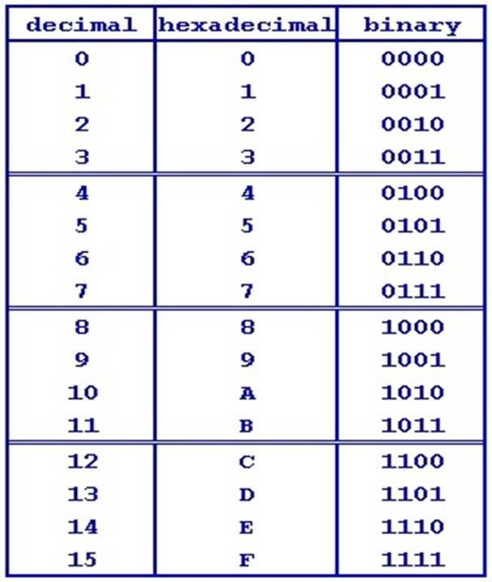
How many hexadecimal digits are needed to define the netid in each of the following classes? Class A
(8 bits) / (4 bits per hex digits) = 2 hex digits

Slide 5
Change the following IP addresses from hexadecimal notation to binary notation:
0x1347FEAB
1=0001, 3=0011, 4=0100, 7=0111
00010011 01000111 11111110 10101011

Slide 6
Change the following IP addresses from binary notation to dotted-decimal notation: 01111111 11110000 01100111 01111101
Digit (start 0 from right) 7 6 5 4 3 2 1 0
Binary Number 0 1 1 1 1 1 1 1
0x2⁷+1x2⁶+1x2⁵+1x2⁴+1x2³+1*2²+1*2¹+1x2⁰
=0 + 64 + 32 + 16 + 8 + 4 + 2 + 1
=127
127.240.103.125

Slide 7
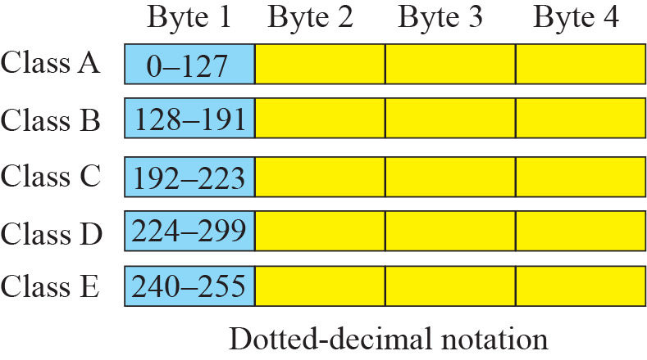
Find the class of the following IP addresses:
208.34.54.12
The first byte is 208 (between 192 and 223) -> Class C

Slide 8
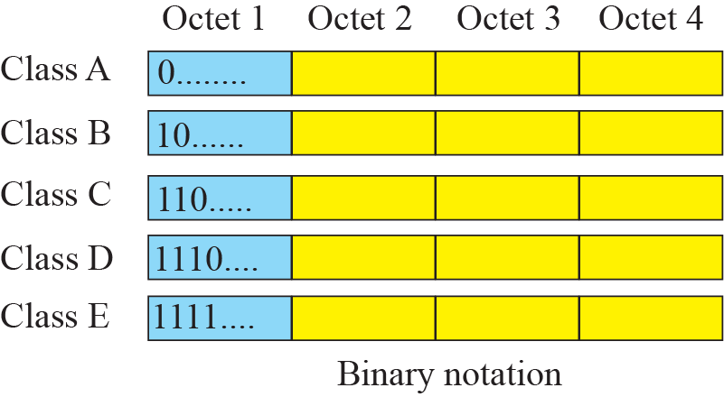
Find the class of the following IP addresses:
11110111 11110011 10000111 11011101
There are four 1’s before the first zero -> Class E

Slide 9
Find the netid and the hostid of the following IP addresses:
114.34.2.8
Class is A -> netid: 114 and hostid: 34.2.8
193.34.2.6 -> netid: 193.34.2 and hostid=: 6

Slide 10
In a class B subnet, we know the IP address of one of the hosts and the subnet mask as given below: 255.255.224.0
What is the first address (subnet address)? What is the last address?
The first address can be found by ANDing the mask with the IP address as shown below:
IP Address: 131 . 134 . 112 . 66
Mask: 255 . 255 . 224 . 0
First Address 131 . 134 . 96 . 0
112=01110000 b
224=11100000 b
AND 01100000 b = 96 d
The last address can be found by ORing the complement of the mask with the IP address (see the section on classless addressing because classful addressing is a special case of classless addressing) as shown below:
IP Address: 131 . 134 . 112 . 66
Mask Complement: 0 . 0 . 31 . 255
Last Address 131 . 134 . 127 . 255
112=01110000 b
31= 00011111 b
OR 01111111 b = 127 d

Slide 11
Find the subnet mask in each case:
32 subnets in class C
In this case, n = 24. We can calculate n_{sub} = 24 + log₂32 = 24+5 = 29. Therefore, the
mask has twenty-nine 1’s and three 0’s. The following shows the mask both in
binary and dotted decimal notation:
Binary 11111111 11111111 11111111 11111000
Decimal 255 . 255 . 255 . 248

Slide 12
In a block of addresses, we know the IP address of one host is 182.44.82.16/26. What is the first address (network address) and the last address (limited broadcast address) in this block?
/26 means the first 26 digit of binary is 1’s
11111111 11111111 11111111 11000000 b= 255.255.255.192 d
With the information given, the first address is found by ANDing the host address with the mask 255.255.255.192 (/26).
Host Address: 182 . 44 . 82 . 16
Mask: 255 . 255 . 255 . 192
Network Address (First): 182 . 44 . 82 . 0
The last address can be found by ORing the host address with the mask complement 0.0.0.63.
Host Address: 182 . 44 . 82 . 16
Mask Complement: 0 . 0 . 0 . 63
Last Address: 182 . 44 . 82 . 63

Slide 13
An organization is granted the block 211.17.180.0/24. The administrator wants to create 32 subnets.
a. Find the subnet mask.
b. Find the number of addresses in each subnet.
c. Find the first and the last address in the first subnet.
d. Find the first and the last address in the last subnet (subnet 32).
a. log₂32 = 5 Possible subnets: 32 Mask: /29 (24+5) or 11111111 11111111 11111111 11111000 b
b. 2³²⁻²⁹ = 8 addresses in each subnet
c. First subnet: The first address is the beginning address of the block.
first address in subnet 1: 211 . 17 . 180 . 0
To find the last address, we need to write 7 (one less than the number of addresses in each subnet) in base 256 (0.0.0.7) and add it to the first address (in base 256).
first address in subnet 1: 211 . 17 . 180 . 0, number of addresses: 0 . 0 . 0 . 7
last address in subnet 1: 211 . 17 . 180 . 7
d. Last subnet (Subnet 5):
To find the first address in subnet 5, we need to add 32 (4 x 8) in base 256 (0.0.0.32) to the first address in subnet 1.
first address in subnet 1 211 . 17 . 180 . 0, number of addresses: 0 . 0 . 0 . 32
first address in subnet 5: 211 . 17 . 180 . 32
Now we can calculate the last address in subnet 5 as we did for the first address.
first address in subnet 5: 211 . 17 . 180 . 32, number of addresses: 0 . 0 . 0 . 7
last address in subnet 5: 211 . 17 . 180 . 39

Slide 14
Find the range of addresses in the following blocks:
123.56.77.32/29
The number of address in this block is 2³²⁻²⁹ = 8. We need to add 7 (one less)
addresses (0.0.0.7 in base 256) to the first address to find the last address.
From: 123 . 56 . 77 . 32
0 . 0 . 0 . 7
To: 123 . 56 . 77 . 39

Slide 15
An ISP is granted a block of addresses starting with 150.80.0.0/16. The ISP wants to distribute these blocks to 2600 customers as follows:
The group has 200 medium-size businesses; each needs approximately 128 addresses.
Design the subblocks and give the slash notation for each subblock. Find out how many addresses are still available after these allocations.
For this group, each customer needs 128 addresses. This means the suffix length is
log₂128 = 7. The prefix length is then 32 - 7 = 25. The range of addresses are given for the first, second, and the last customer. The range of addresses for other customers can be easily found:
1st customer: 150.80.0.0/25 to 150.80.0.127/25
2nd customer: 150.80.0.128/25 to 150.80.0.255/25
...
200th customer: 150.80.99.128/25 to 150.80.99.255/25
Total addresses for group 1 = 200 x 128 = 25,600 addresses

